Slide 1
Python Implementation of Efficient conversion of RLGC distributed parameters to S parameters for multi-port systems
Davit Kharshiladze
Yifan Ding
Chulsoon Hwang
Hyunwook Park

Slide 2
Table of Contents
Implementing Algorithm in Python
Comparison of Calculation Times and Accuracy Between MATLAB And Python
Optimizing Python Code Using Numba Library

Slide 3
Implementing Algorithm in Python
By converting code from MATLAB to python, many problems may arise. MATLAB is optimized for matrix operations, such as matrix multiplication, matrix inversion, etc. Python struggles to keep up the calculations under the same conditions as MATLAB
Python has many functions that can do the same thing. For example, matrix multiplication can be done by several different methods.
4x4 matrices with random values were multiplied together 100,000 times, by different functions. The time needed for calculation was noted
MATLAB
A * B
0.013776 s
Python
Python
@
0.17464923858642578 s
numpy.matmul
Python
Python
0.1545870304107666 s
numpy.dot
dot
0.10571694374084473 s
0.10073018074035645 s
MATALB multiplication is 10 times faster!
This means that algorithms, based on matrix multiplication will not be as effective in python.
Choosing right simple operations scales well when the problem size increases.

Slide 4
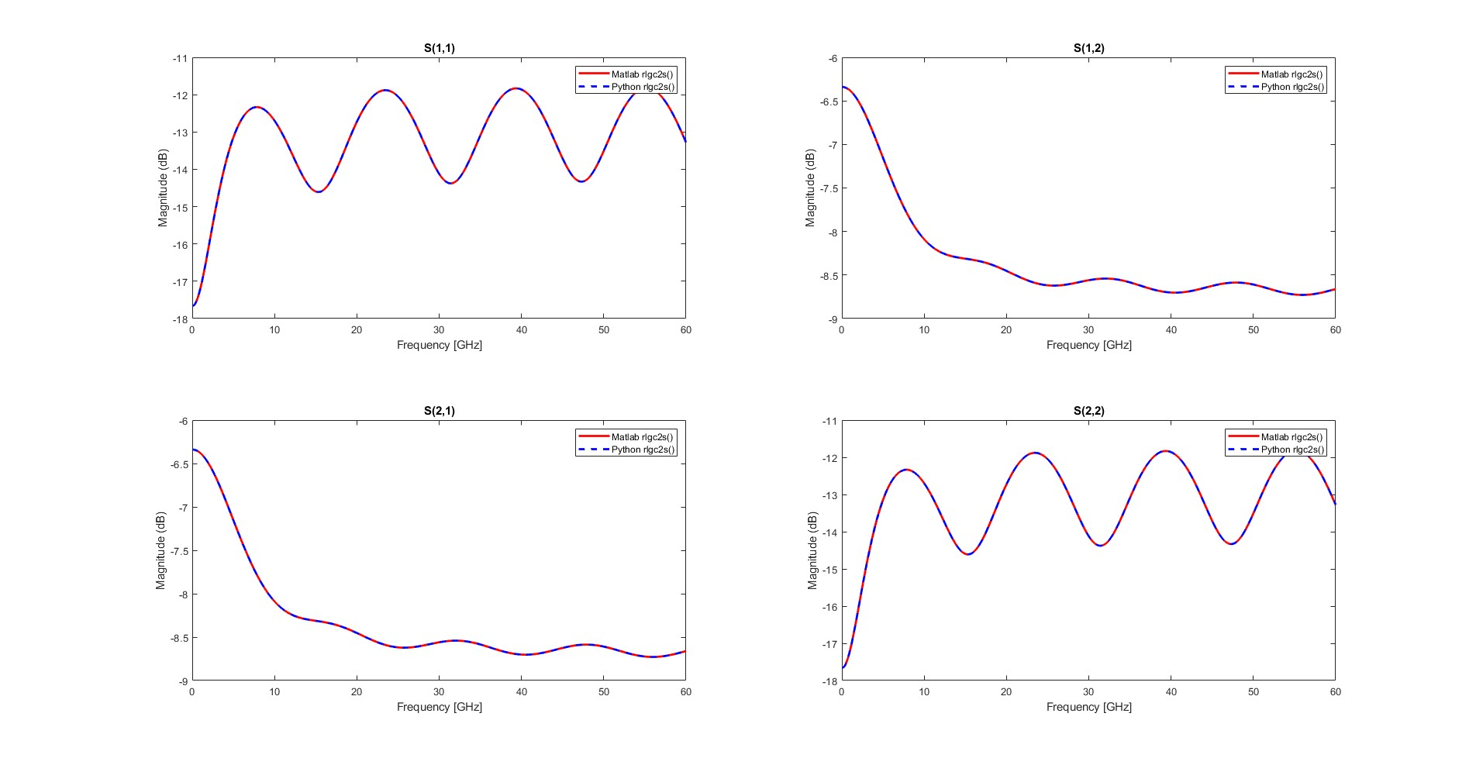
Accuracy Between MATLAB And Python – 1x1 RLGC (Frequency Independent)

Slide 5
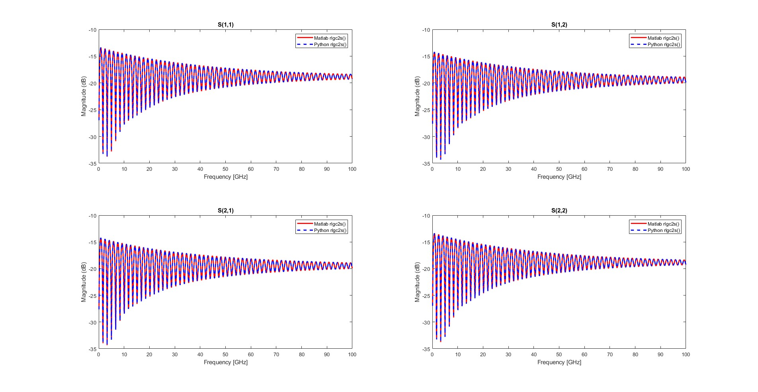
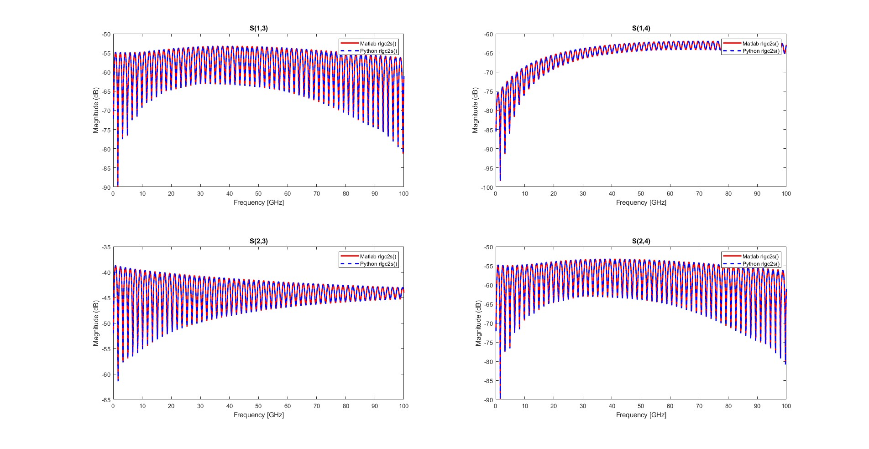
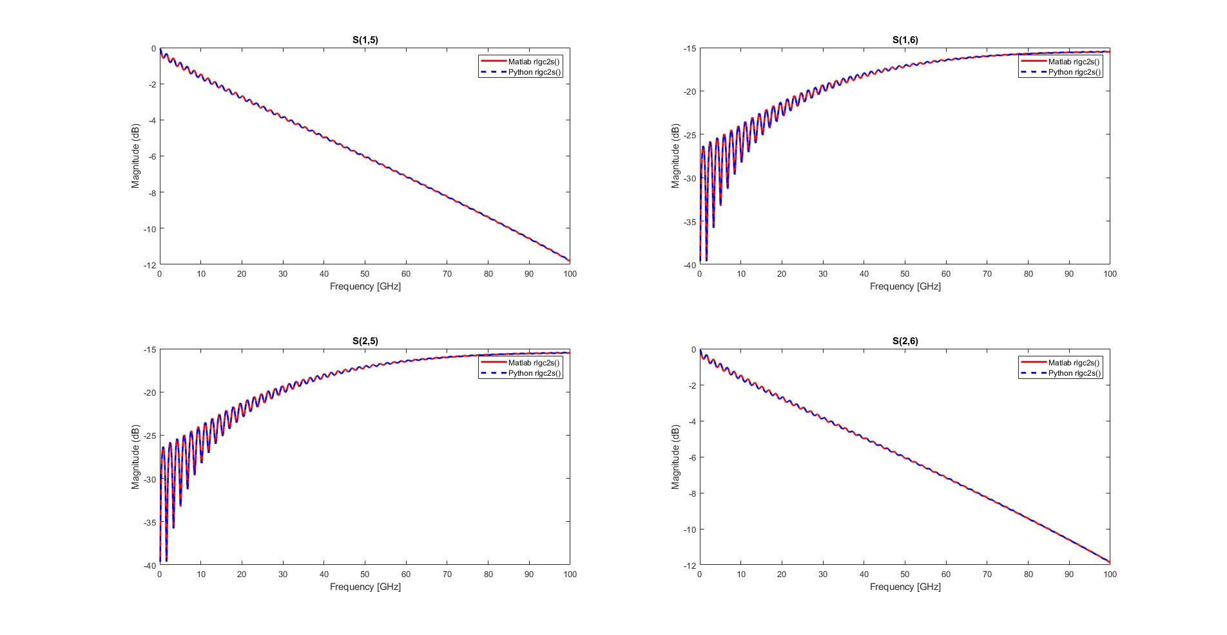
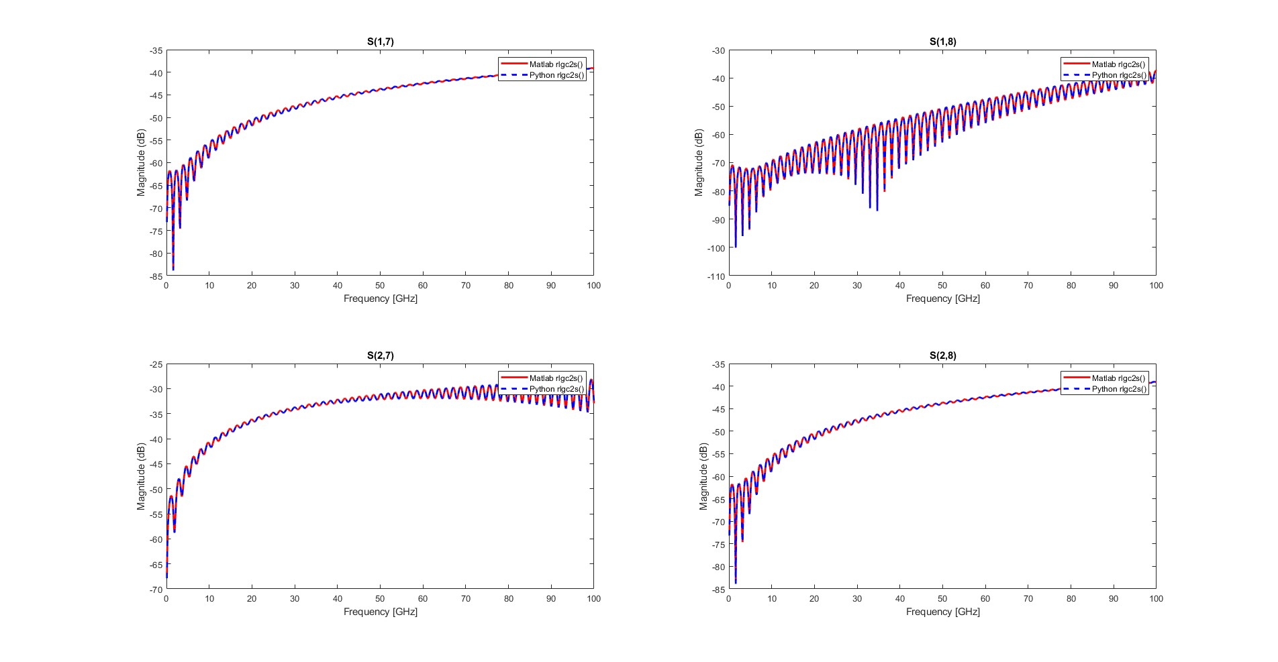
Accuracy Between MATLAB And Python – 4x4 RLGC (Frequency Dependent, IMLC)

Slide 6
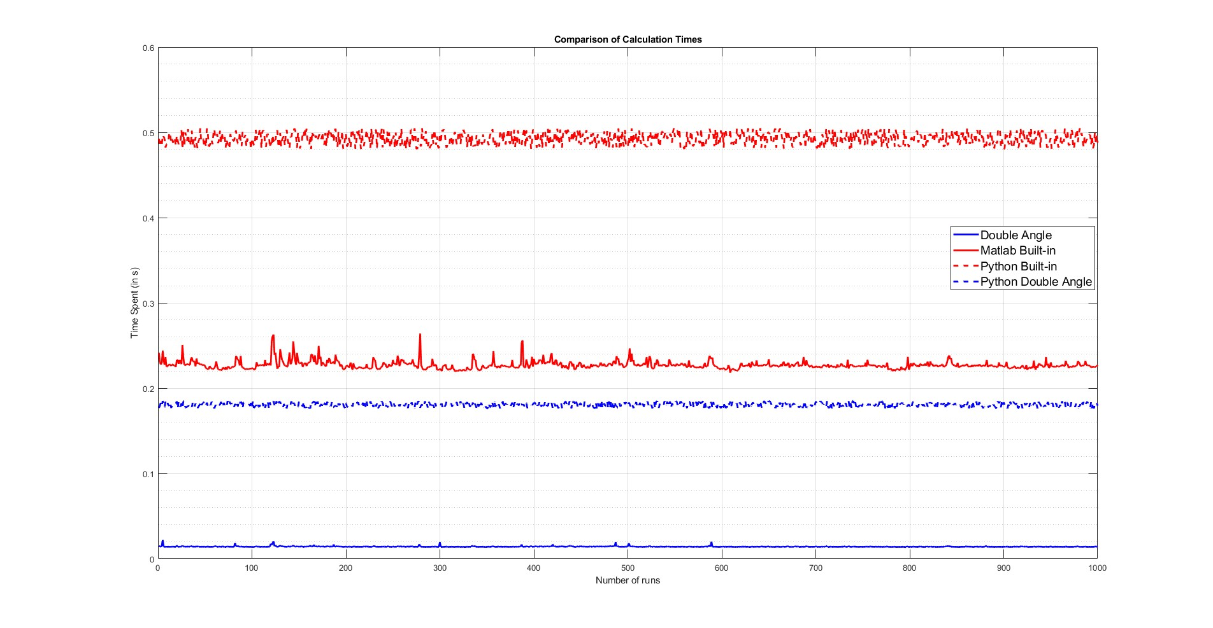
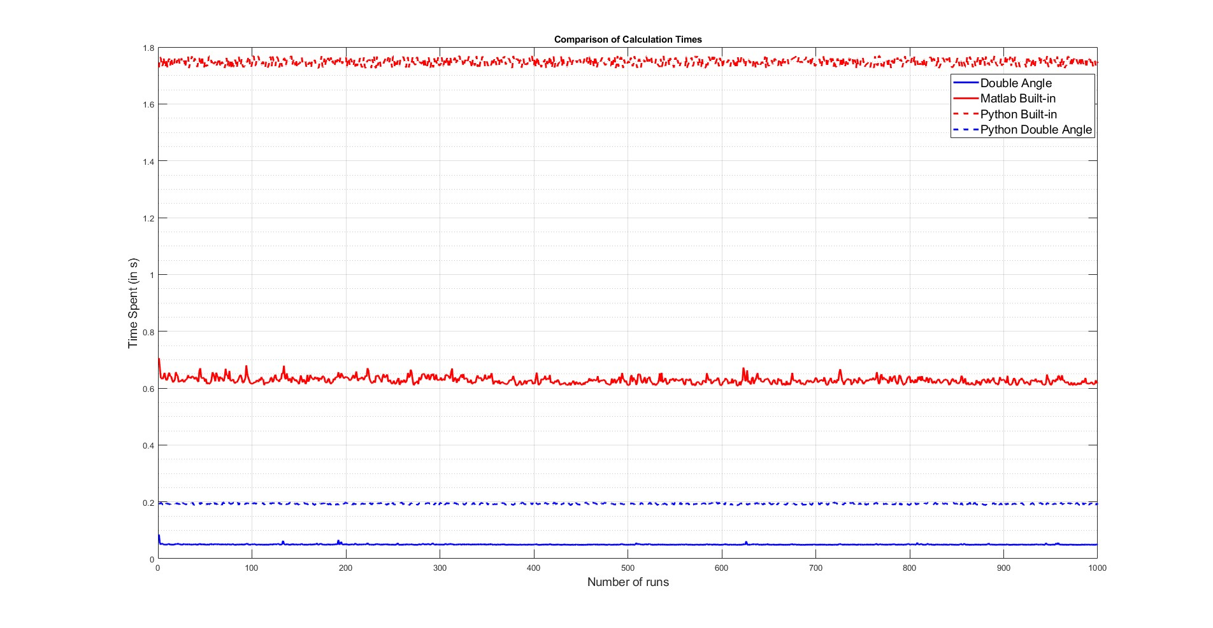
Calculation Times Between MATLAB And Python
1x1 RLGC Matrix
Frequency Independent
4x4 RLGC Matrix
Frequency Dependent (IMLC)
Directly converting MATLAB code to python has undesired results. In 1x1 case, double-angle algorithm barely achieves same calculation time as MATLAB’s built-in rlgc2s()
Calculations were done for frequencies 40MHz to 100GHz with 1000 frequency points
All calculations were done on Intel® Core i5-10500 Processor : Base Speed – 3.1GHz, Cores – 6, RAM – 16GB

Slide 7
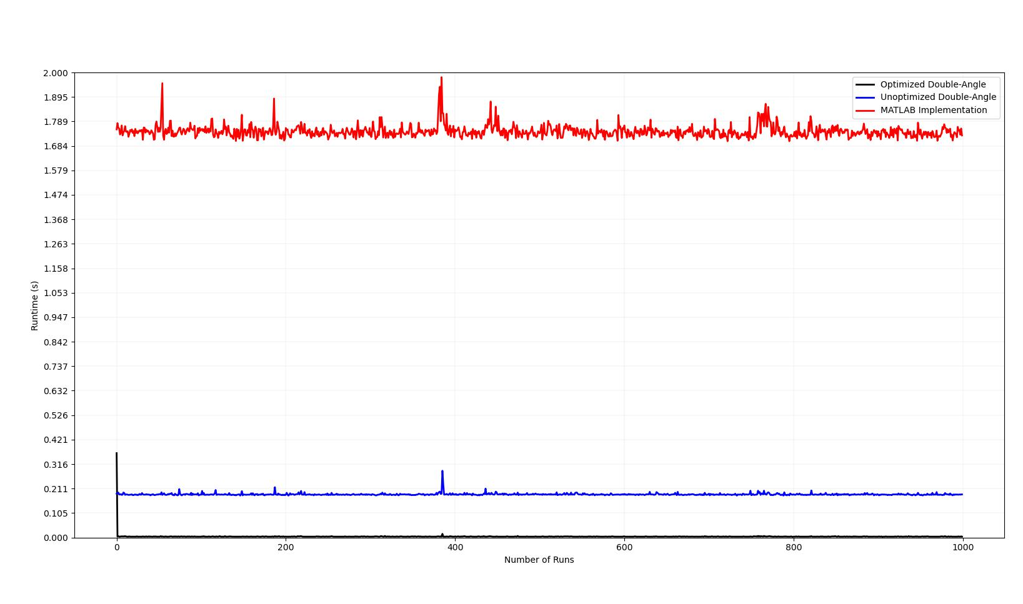
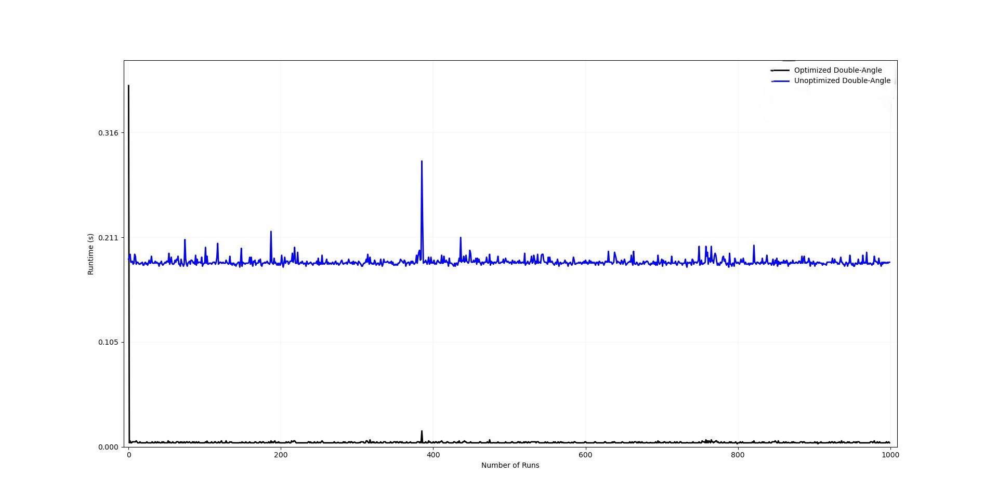
Optimizing Python Code Using Numba Library
By using Numba Python library, certain improvement can be made to calculation speed, without harming the accuracy
4x4 RLGC Matrix
Frequency Dependent (IMLC)
First time the function is called, it takes large amount of time to cache/decache it for compilation purposes
0.41863 s
1.72439 s
0.1935112 s
0.0045198 s
Numba library compiles code instead of interpreting it like python. After compilation, certain function can be especially optimized. Optimized double-angle function is 42 times faster than unoptimized double-angle algorithm implemented in python.
Optimized double-angle algorithm is 10 times faster than its MATLAB equivalent
Calculations were done for frequencies 40MHz to 100GHz with 1000 frequency points
All calculations were done on Intel® Core i5-10500 Processor : Base Speed – 3.1GHz, Cores – 6, RAM – 16GB

Slide 8
Thank you for attention!

